Slide 1




Quantum Error Correction using Isometric Embedding
Sharjeel Ahmad¹, Hussain Ali Razvi¹, Elio Thadhani², Facundo Martin Lopez³, Eric Chitambar¹
1. University of Illinois at Urbana Champaign 2. Harvey Mudd College, 3. Carleton College

Slide 2

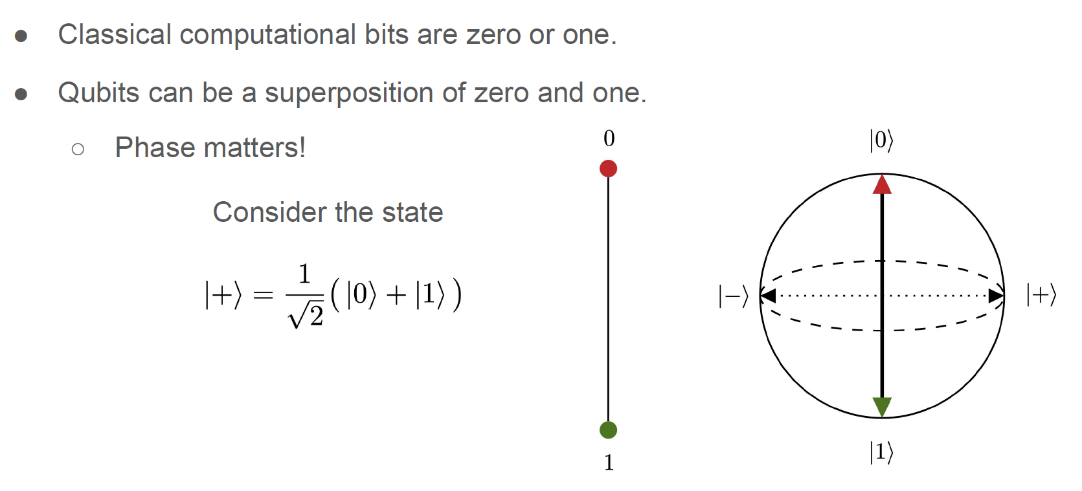
What is a Qubit?
UNIVERSITY OF ILLINOIS URBANA-CHAMPAIGN
GRAINGER ENGINEERING

Slide 3
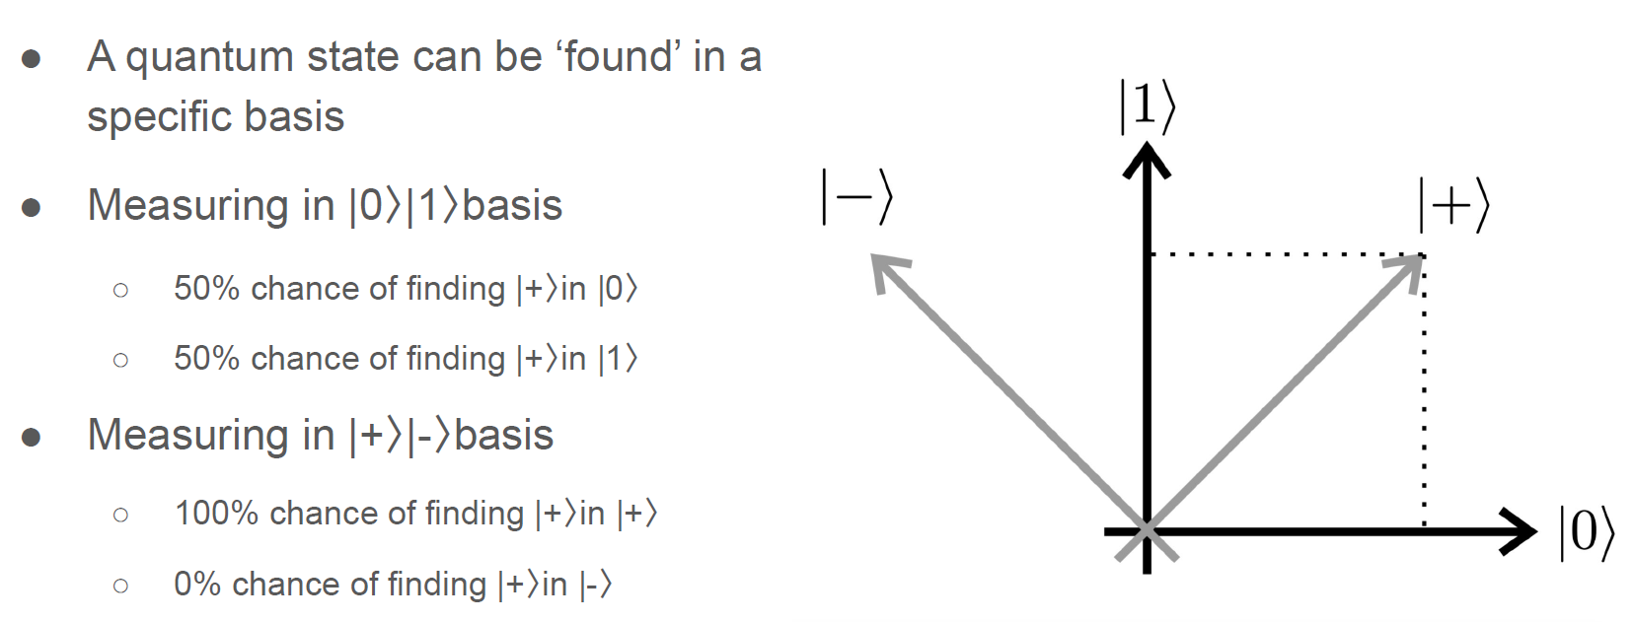
Superposition
UNIVERSITY OF ILLINOIS URBANA-CHAMPAIGN
GRAINGER ENGINEERING

Slide 4
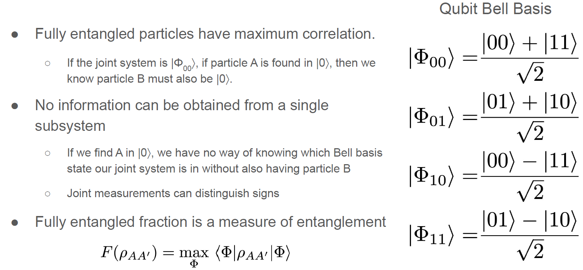
Entanglement
UNIVERSITY OF ILLINOIS URBANA-CHAMPAIGN
GRAINGER ENGINEERING

Slide 5
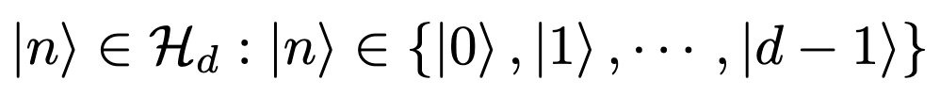
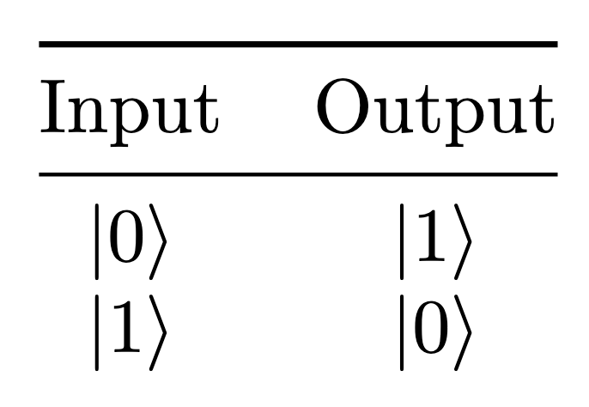
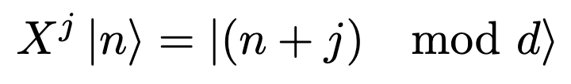
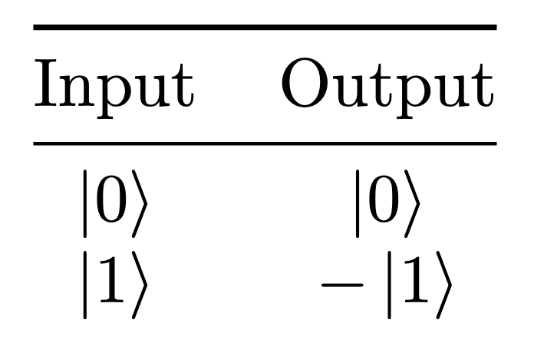
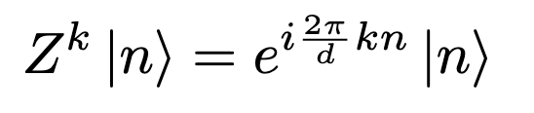
Quantum gates: Pauli operators
Pauli X gates ‘shift’ the computational basis
Pauli Z gates add a phase factor
UNIVERSITY OF ILLINOIS URBANA-CHAMPAIGN
GRAINGER ENGINEERING

Slide 6
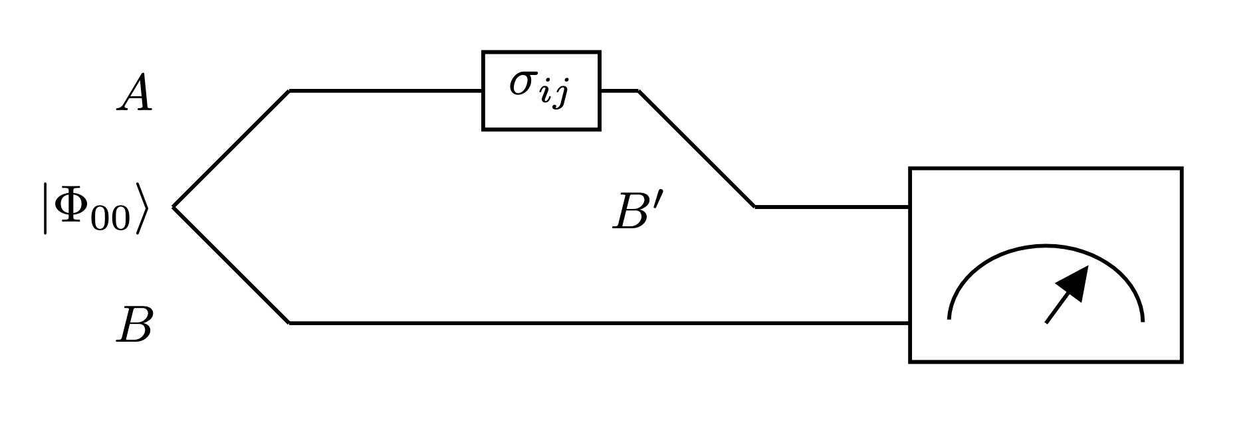
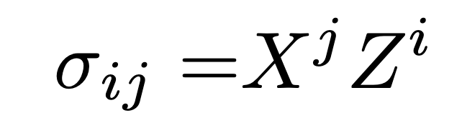
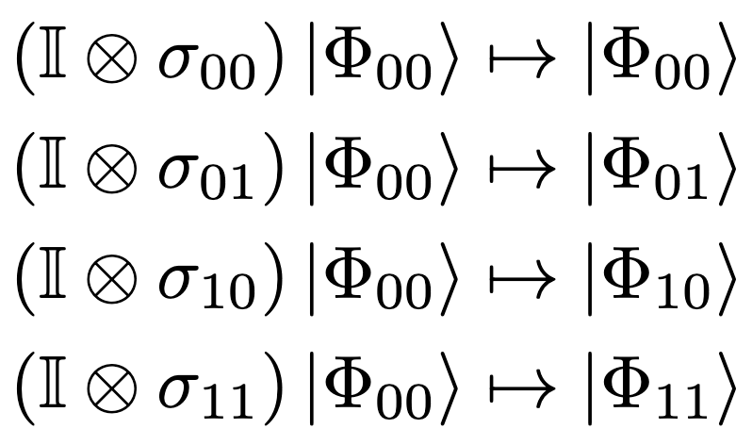
Dense Coding (qubit case)
Pauli operators can be used to rotate the state
A two-bit message can be encoded by performing one of four Pauli operators on one subsystem, transforming the joint state.
Z gates effect phase
X gates can be thought of as a bit flips
Figure 1: Dense coding protocol diagram for the qubit qubit case.
UNIVERSITY OF ILLINOIS URBANA-CHAMPAIGN
GRAINGER ENGINEERING

Slide 7
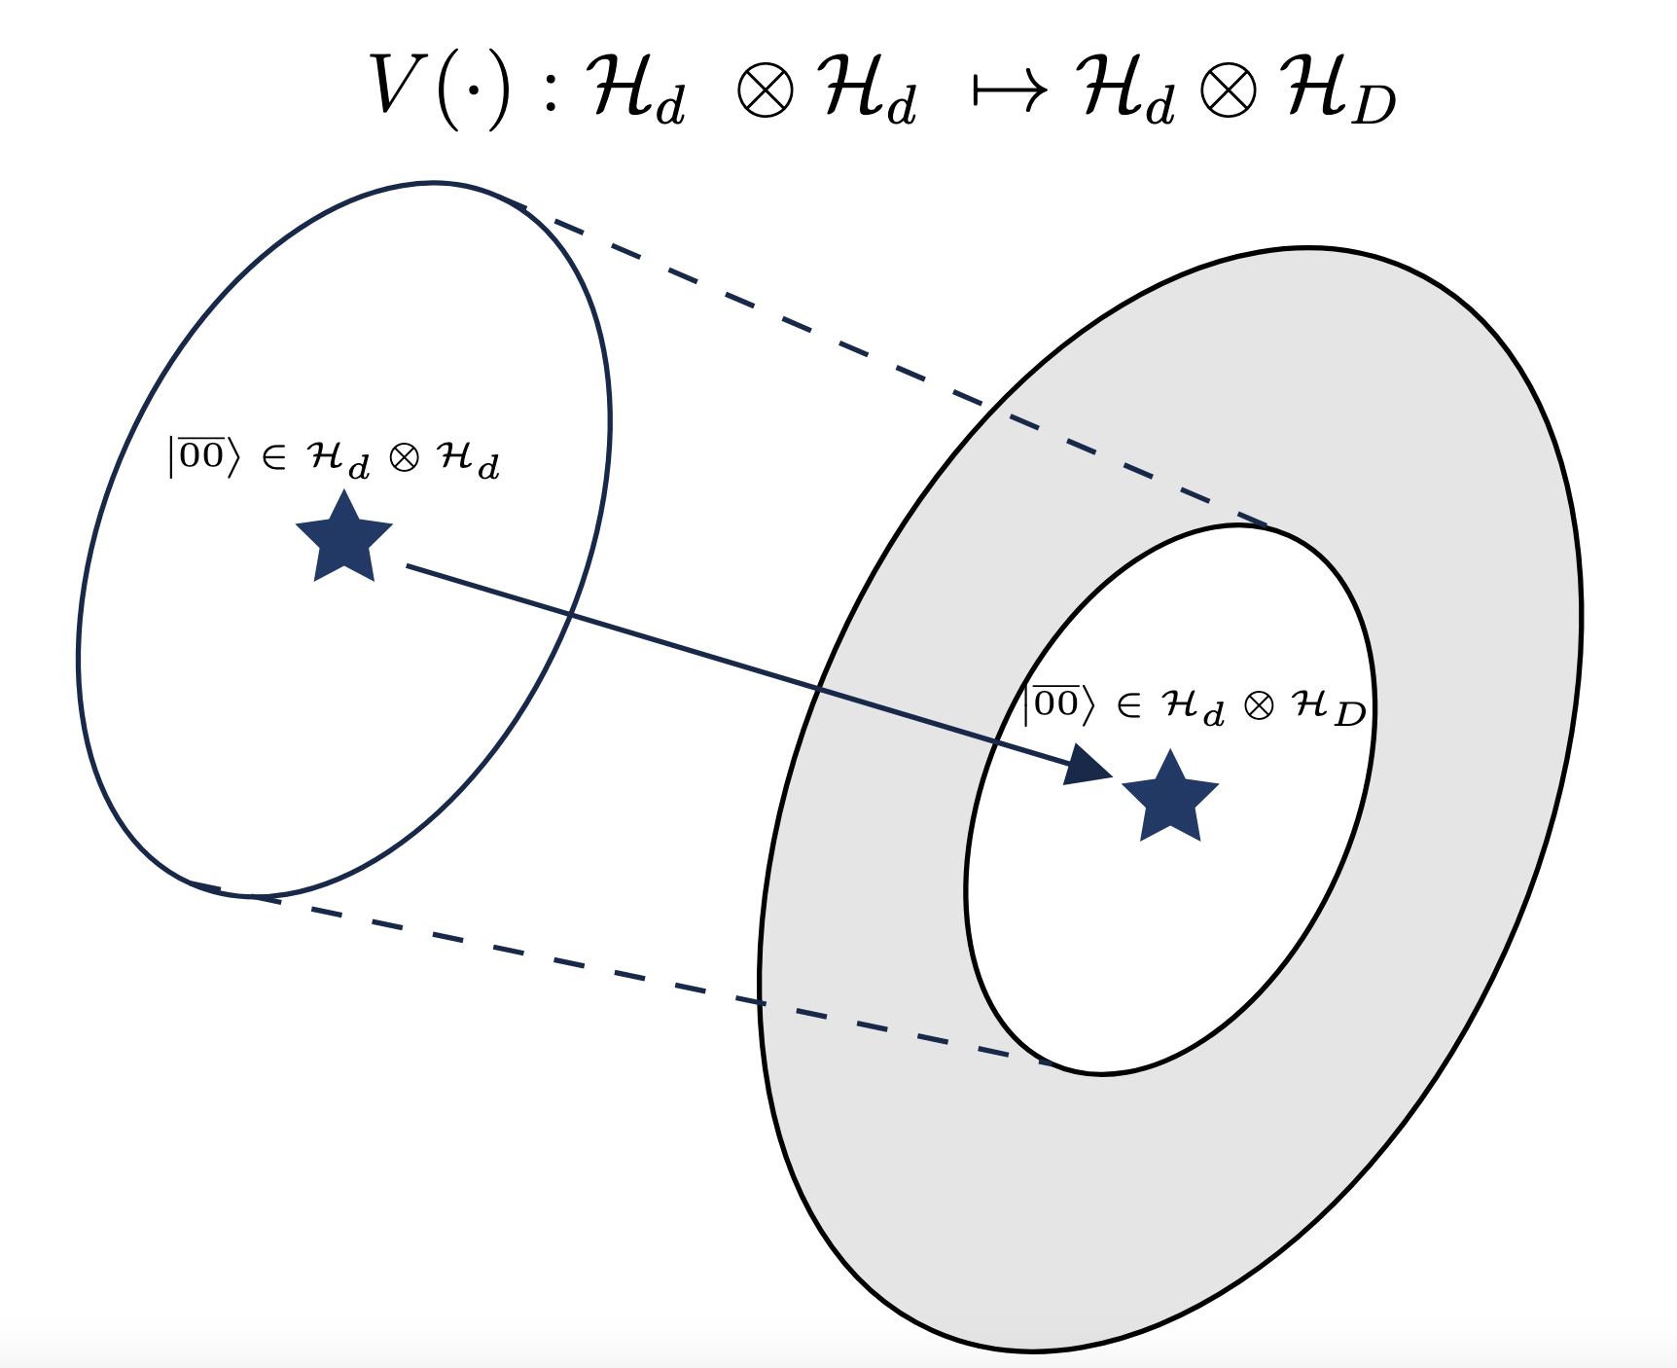
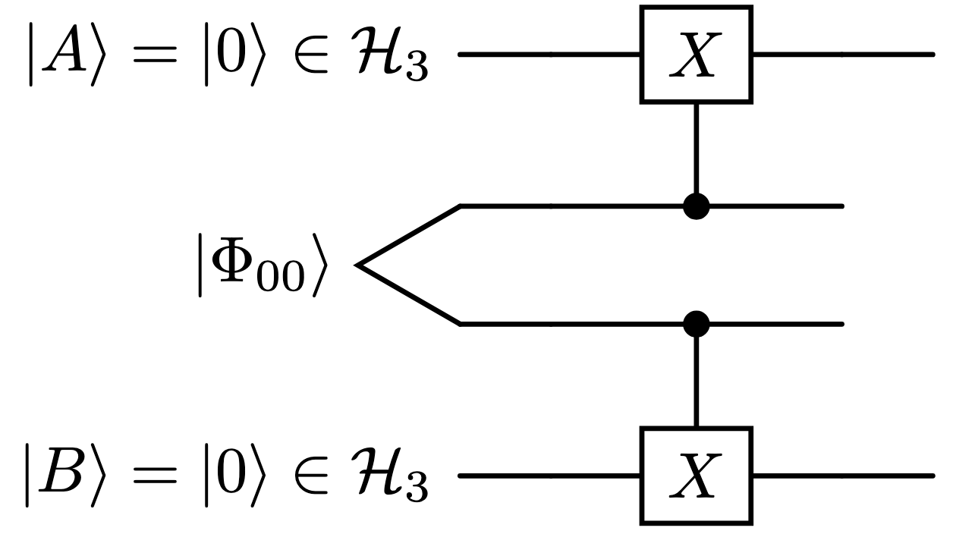
Higher Dimensional Embedding
A quantum state existing in the Hilbert space ℋ_{A} can be embedded into a higher dimensional space ℋ_{B} via isometric embedding
A relatively simple circuit exists for the qubit to qutrit case
Figure 3: A Isometric embedding of a lower dimensional quantum state space into a higher dimensional space.
Figure 2: Embedding circuit for embedding a qubit bipartite state into qutrit space. This circuit utilizes control pauli X(1) gates in the qutrit space.
UNIVERSITY OF ILLINOIS URBANA-CHAMPAIGN
GRAINGER ENGINEERING

Slide 8
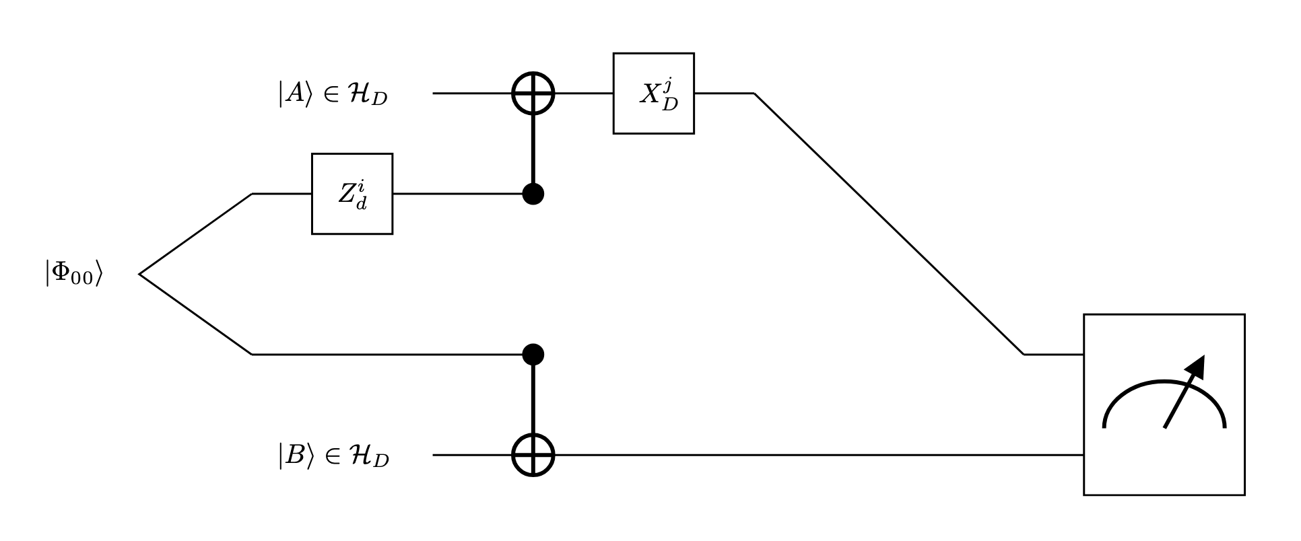
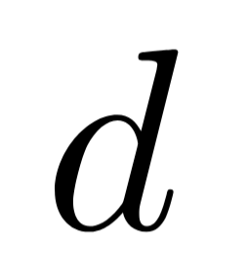
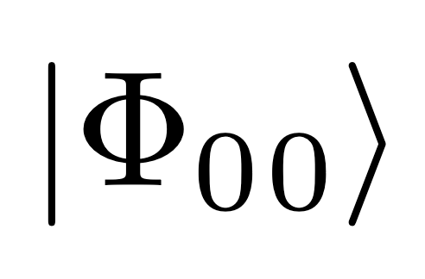

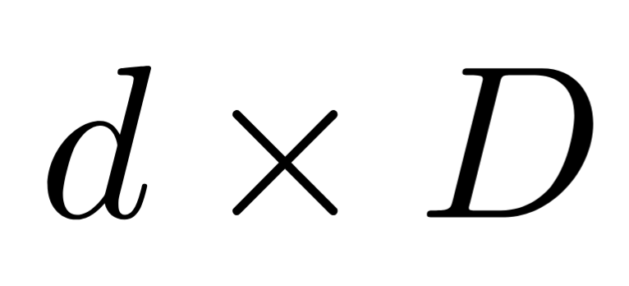
Embedded Dense Coding
Alice and Bob share an entangled pair of dimensional qudits.
Alice applies one of possible Z gates.
Alice and Bob embed their system into a higher dimensional space.
Alice applies one of possible X gates
Alice sends her qubit to Bob, who can now with his qudit decode which of the possible operations were applied
Figure 4: Embedded dense coding circuit for a qubit to qudit case. Note the measurement represents a measurement in the encoding basis.
UNIVERSITY OF ILLINOIS URBANA-CHAMPAIGN
GRAINGER ENGINEERING

Slide 9
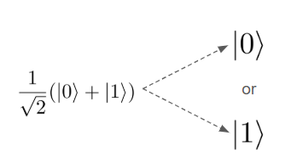
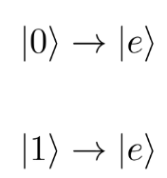
Embedded Dense Coding: Dephrasure
Embedded Dense coding performance when quantum communication passes through a “dephrasure” (erasure and dephasing) channel.
p is the probability of dephasing | q is the probability of erasure
Loss of superposition. Qubit acts like classical bit with an unknown value and is indistinguishable from other superpositions | Qubits are sent to another state labeled e. It is not 0, 1 or a superposition of both. No information can be recovered.
UNIVERSITY OF ILLINOIS URBANA-CHAMPAIGN
GRAINGER ENGINEERING

Slide 10
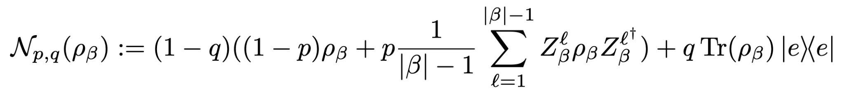
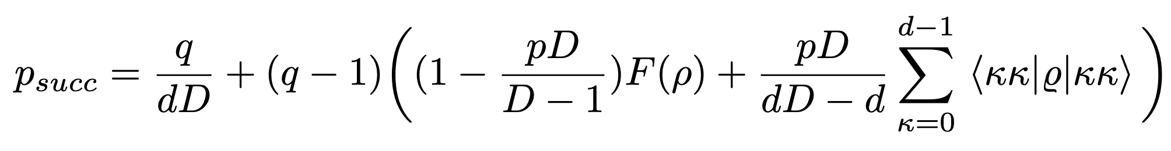
Embedded Dense Coding: Dephrasure
The dephrasure channel is modeled with the equation:
From it, we can derive the success probability of EDC through a dephrasure channel
UNIVERSITY OF ILLINOIS URBANA-CHAMPAIGN
GRAINGER ENGINEERING

Slide 11
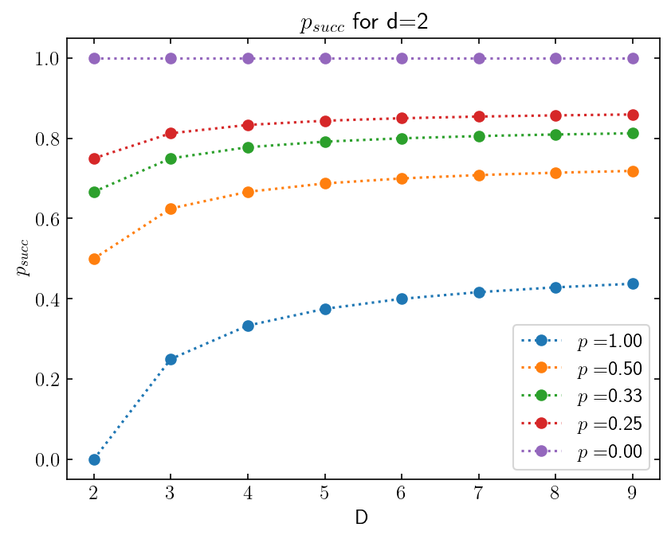
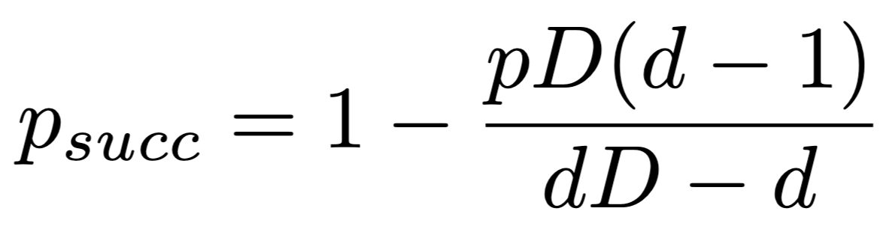
Embedded Dense Coding: Dephrasure
In the case of a perfectly entangled resource with zero erasure:
Figure 5: Analytical projection of success probability of a EDC scheme as D changes.
UNIVERSITY OF ILLINOIS URBANA-CHAMPAIGN
GRAINGER ENGINEERING

Slide 12
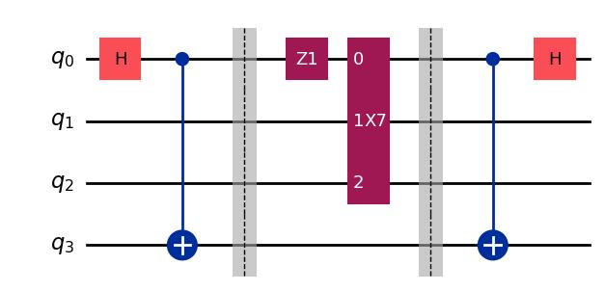
Embedded Dense Coding: Computer Performance
The protocol was tested on IBM Quantum Computers
Comparing theoretical predictions to performance with real noise
Verify the protocol can be carried out on current hardware
Alice applies 1 of 16 operations
Bob decodes operations done
Qubits entangled
Alice sends Bob qubit
Alice
Figure 6: Embedded Dense coding protocol adapted to a Qiskit quantum circuit capable of running on a quantum computer
Bob
UNIVERSITY OF ILLINOIS URBANA-CHAMPAIGN
GRAINGER ENGINEERING

Slide 13
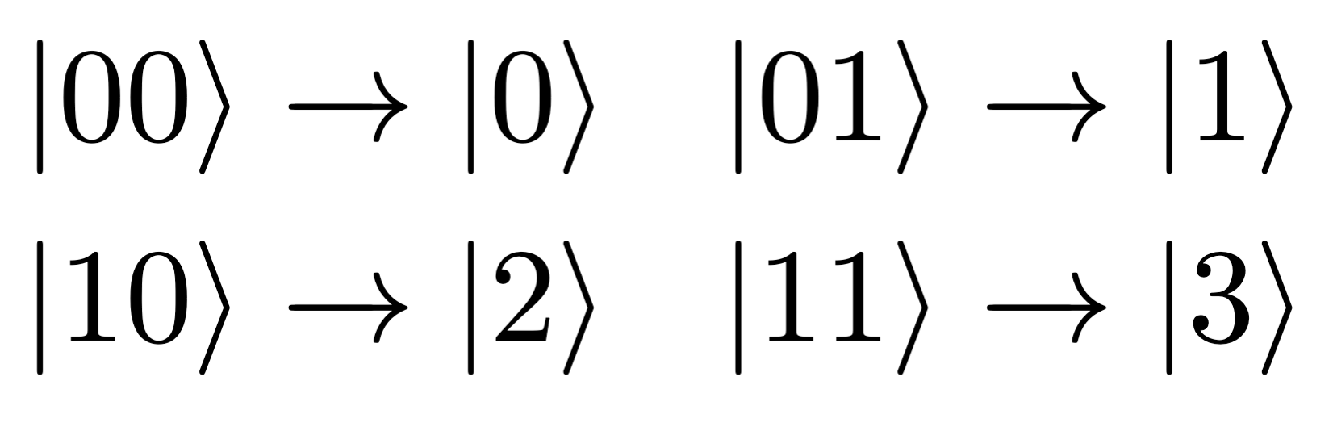
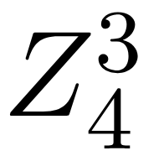
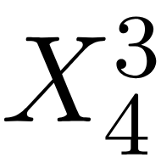
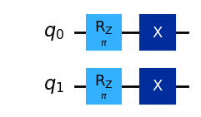
Embedded Dense Coding: Qubit Encoding
Some adaptations were necessary:
No native support for qudits of arbitrary dimension
No control over type of noise
Qubit Encoding:
We can simulate the behavior of a D dimensional qudit using log2(D) qubits
If D is a power of 2, encoding the operator gates becomes trivially simple
(Example of a pair of qubits being encoded into a 4-state qudit)
Figure 7: A and gate in qiskit when encoding a ququart using two qubits
UNIVERSITY OF ILLINOIS URBANA-CHAMPAIGN
GRAINGER ENGINEERING

Slide 14
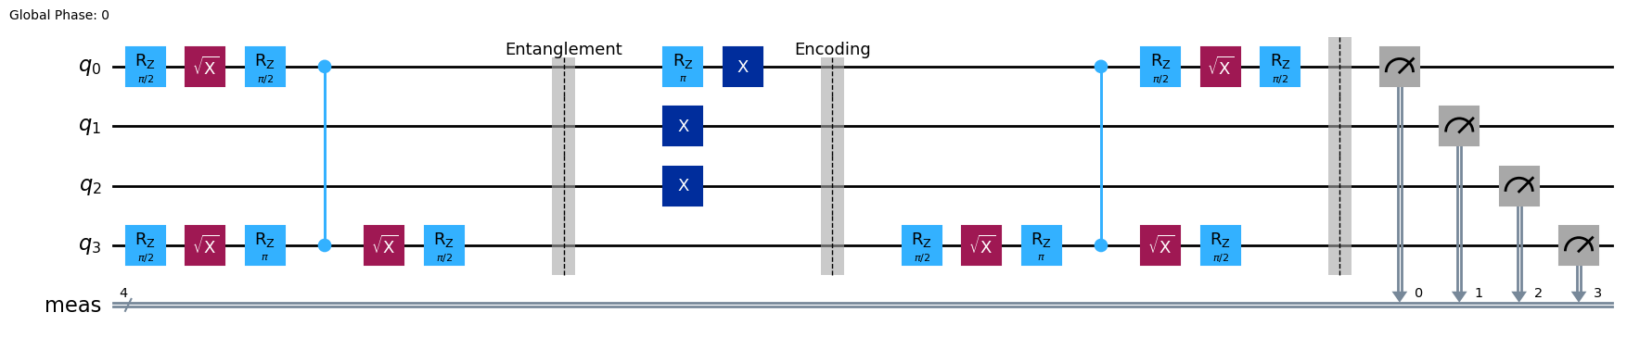
Embedded Dense Coding: Noise on the IBM Torino Platform
Noise on the IBM Torino quantum computer:
We don’t simulate the physical transfer of the qudit from Alice to Bob, which in real applications would be a source of noise to consider
Instead, we only have the noise from the native gates
Figure 8: Embedded Dense Coding protocol for d = 2, D = 8, transpiled to the native basis gates for the IBM Torino Quantum Computer: X, RZ, SX, CZ. Dashed vertical lines added for visualization purposes.
UNIVERSITY OF ILLINOIS URBANA-CHAMPAIGN
GRAINGER ENGINEERING

Slide 15
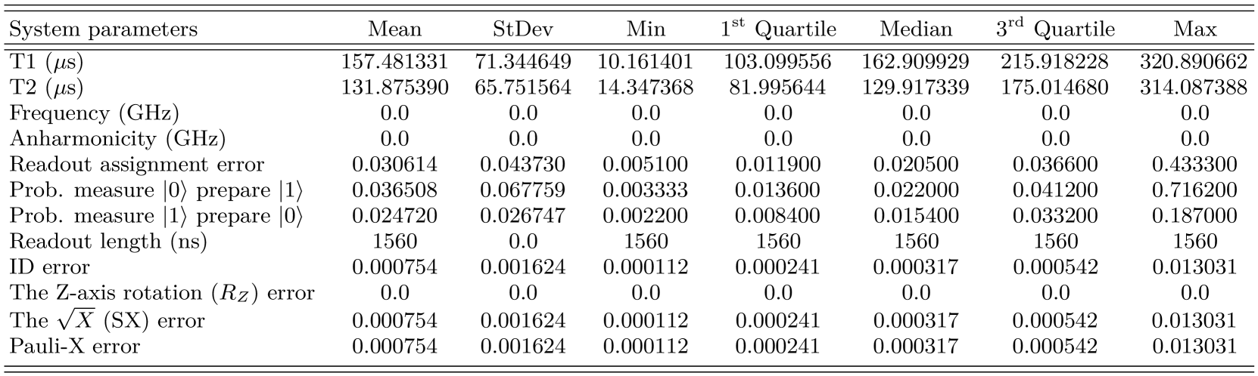
Embedded Dense Coding: Noise on the IBM Torino Platform
Noise on the IBM Torino quantum computer:
Table 1: Summary of hardware performance, qubit characteristics, and key specifications for the 133 qubit quantum computer ibm_torino. The basis gates of this machine are CZ, ID, RZ, SX, and X. The processor type is Heron r1 (version 1.0.22). As of July 3, 2024, the system demonstrates a median CZ error of 4.769×10⁻³, and a median gate time of 84 ns. AbuGhanem, M. (2024). IBM quantum computers. arXiv:2410.00916.
UNIVERSITY OF ILLINOIS URBANA-CHAMPAIGN
GRAINGER ENGINEERING

Slide 16
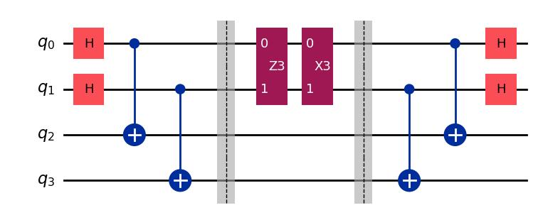
Embedded Dense Coding: EDC as a Quantum Circuit
Full circuits comparison: Dense coding for two d = D = 4 qudits vs. Embedded Dense coding for one qubit and one D=8 qudit
Alice applies 1 of 16 operations
Bob decodes operations done
Alice embeds her qubit to D = 8 and applies 1 of 16 operations
Bob decodes operations done
Qudits entangled
Alice sends Bob qubit
Qubits entangled
Alice sends Bob qubit
Alice
Alice
Bob
Bob
Figure 9: Standard Dense Coding for 4 classical bits circuit ran on IBM Torino.
Figure 10: Embedded Dense Coding circuit for 4 classical bits ran on IBM Torino.
UNIVERSITY OF ILLINOIS URBANA-CHAMPAIGN
GRAINGER ENGINEERING

Slide 17
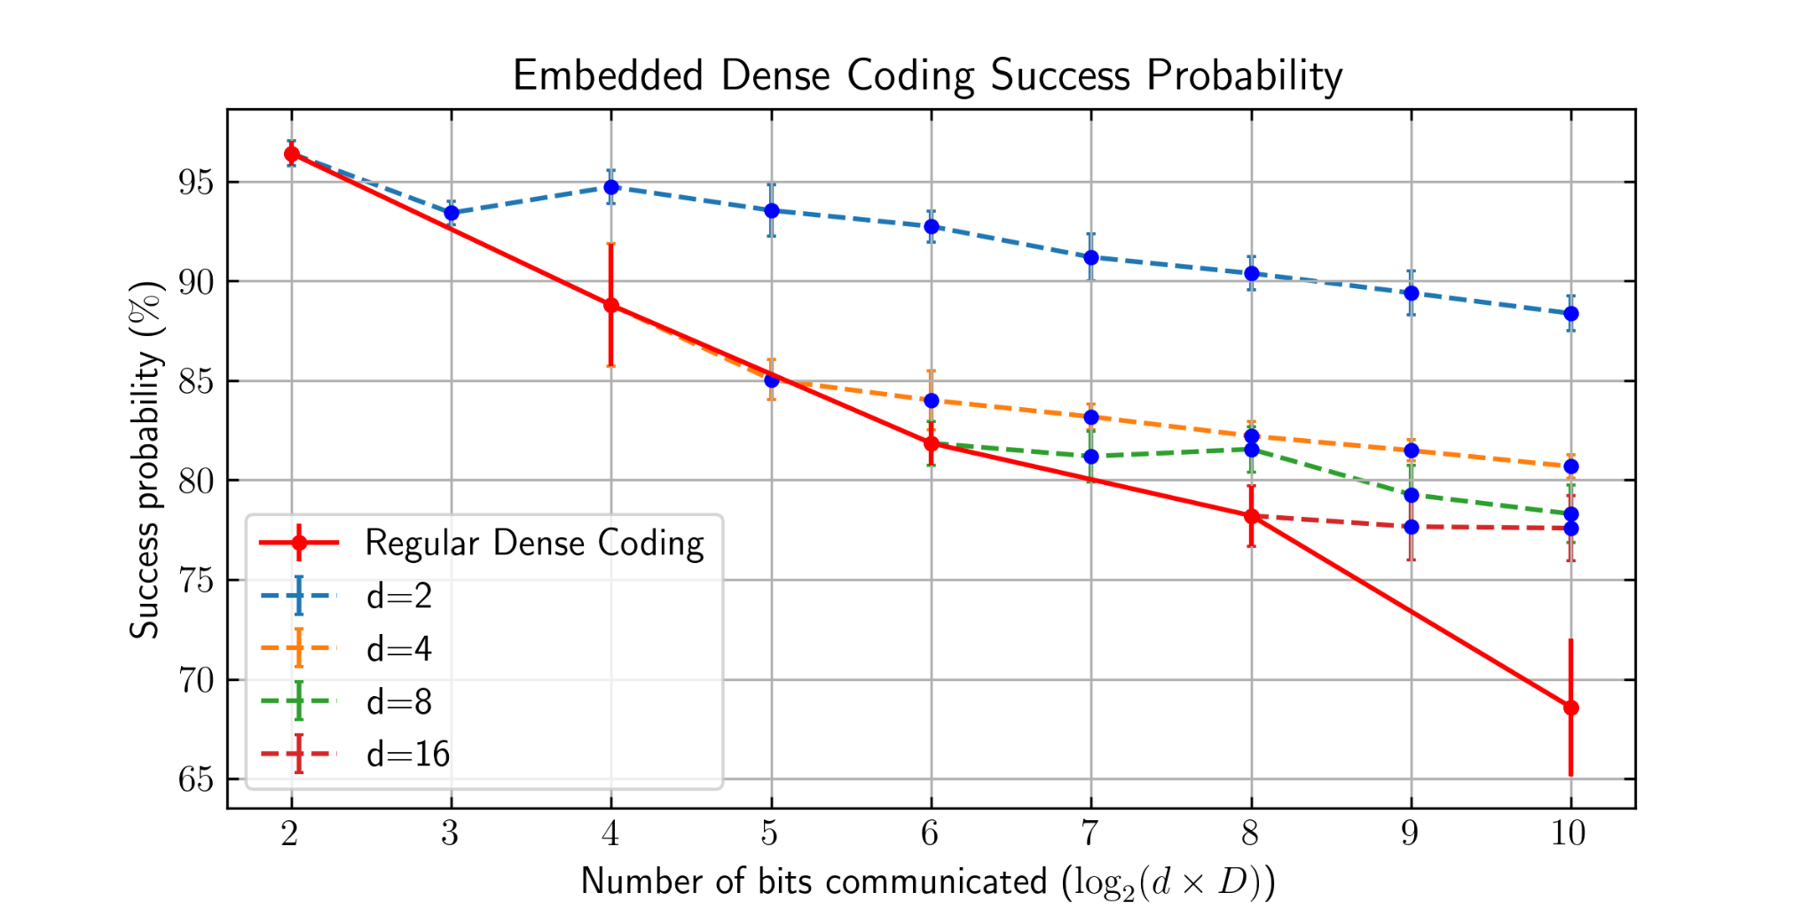
Embedded Dense Coding: IBM Computer Performance
Figure 11: Results of EDC protocol performed on IBM Torino quantum computer for various starting and embedding dimensions. 10,000 shots were performed for three separate trials.
UNIVERSITY OF ILLINOIS URBANA-CHAMPAIGN
GRAINGER ENGINEERING

Slide 18
Conclusion and Next Steps
Conclusion
Embedded Dense Coding utilizes higher dimensional embedding to gain a fidelity advantage
Our protocol has been implemented and tested on IBM quantum computers
Next Steps
Calculate effects of other forms of noise in quantum channels and its interaction with embedded protocols (depolarizing noise)
Prove agreement with Holevo’s theorem
Explore other forms of error correcting codes that utilize embedding
Potentially run protocol for cases without bell pair entanglement
UNIVERSITY OF ILLINOIS URBANA-CHAMPAIGN
GRAINGER ENGINEERING

Slide 19
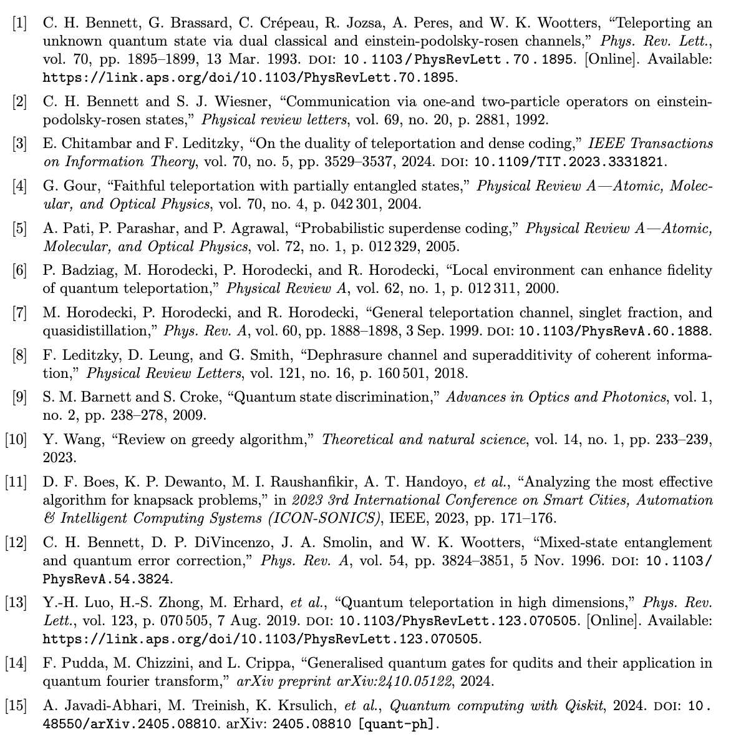
Citations and Acknowledgements
We would like to thank the Chicago Quantum Exchange OQI undergraduate fellowship, the NSF UIUC Physics REU, the University of Illinois Urbana Champaign, and the Chitambar research group at UIUC.
This material is based upon work supported by the National Science Foundation PHY-2244433.
Any opinions, findings, and conclusions or recommendations expressed in this material are those
of the author(s) and do not necessarily reflect the views of the National Science Foundation
UNIVERSITY OF ILLINOIS URBANA-CHAMPAIGN
GRAINGER ENGINEERING

Slide 20
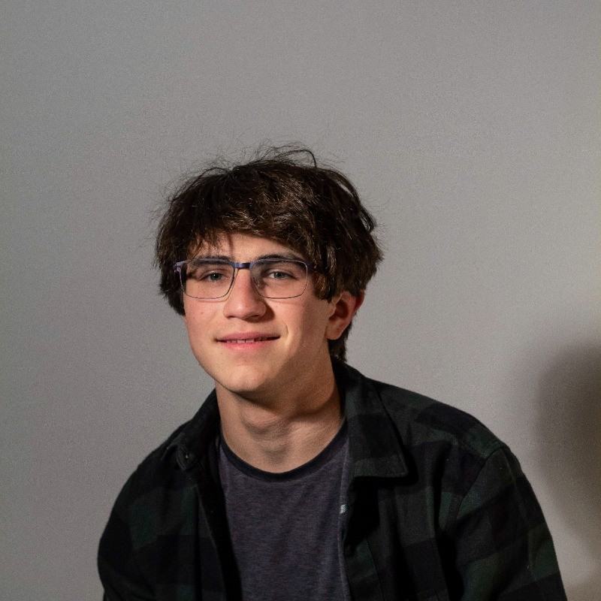
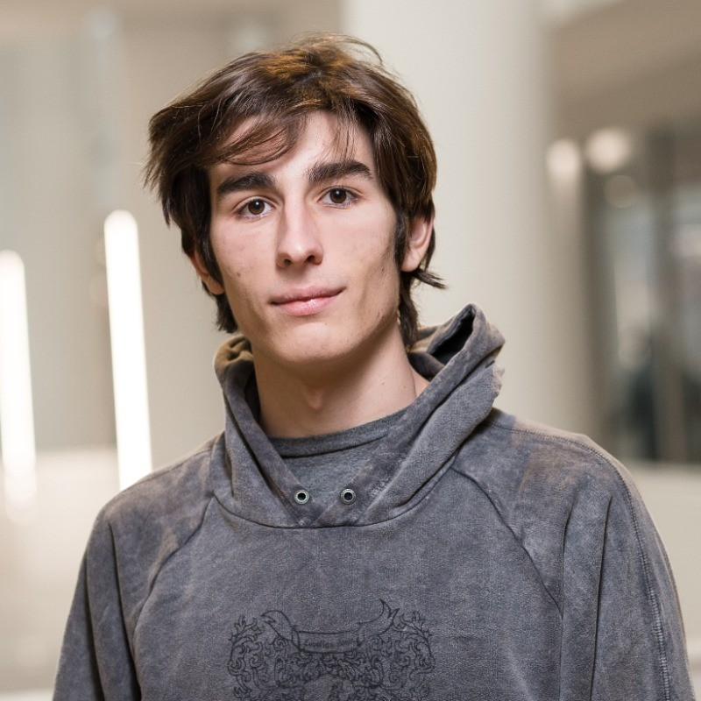

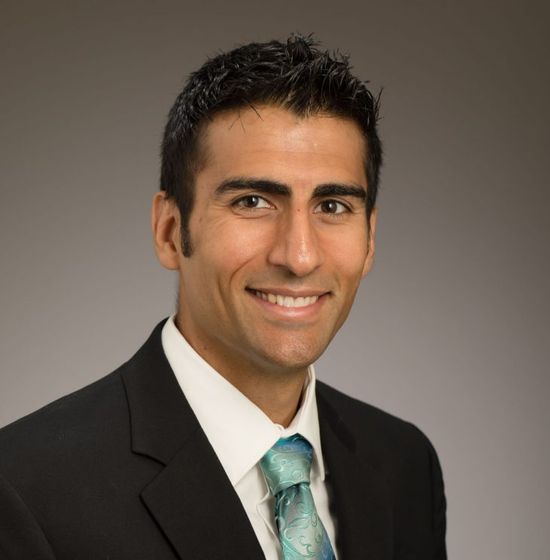
Collaborators
Elio Thandani
Harvey Mudd College
Facundo Martin Lopez
Carleton College
Hussain Razvi
UIUC
Prof. Eric Chitambar
UIUC Principle Investigator

Slide 21
Questions?

